Slide 1
Measurement and Performance in the Medicare Quality-Based Payment Programs
John Gravina, Senior Director, Health Economics
Amy Chin, Assistant Vice President, Center for the Advancement of Value in Musculoskeletal Care
May 2023

Slide 2
Introduction
This presentation is an introduction to (or refresher of) the ACA quality–based payment programs under the IPPS:
Hospital-Acquired Conditions (HAC) Reduction Program
Hospital Value-Based Purchasing (VBP) Program
Hospital Readmissions Reduction Program (HRRP)
It will cover both quality and finance concepts and the link between the two
Note: Due to the COVID-19 PHE there were no payment adjustments through the VBP program in 2022 and 2023 and HAC program in 2023

Slide 3
Medicare Payment Terminology
Federal fiscal year (FY)
October 1 – September 30
FY 2021: Oct. 1, 2020 – Sept. 30, 2021
Fee-for-service (FFS)
Providers are paid for each service provided
Prospective payment system
Reimbursement system based on predetermined amounts
Uses a system of classifying conditions or services that is linked to reimbursement
Inpatient prospective payment system (IPPS)
Reimburses primarily for hospital inpatient services
Reimbursement based on Medicare Severity Diagnosis Related Groups (MS-DRGs)
To learn more about health care terminology, please see GNYHA Health Care Terms 2022

Slide 4
Learning Objectives
Understand the methodology used to evaluate performance in the HAC, VBP, and HRRP programs
Review the financial implications of performance in these programs
Actions you can take to improve your scores and how these changes impact payments

Slide 5
Medicare Inpatient Quality-Based Payment Program Overview
Hospital Acquired Conditions Reduction Program (HAC)
Started in 2015
Maximum penalty is 1% of total Medicare payments
Value Based Purchasing Program (VBP)
Started in 2013
Maximum penalty is 2% of Medicare base operating payments
Only program with potential to earn a bonus and accounts for improvement
Hospital Readmissions Reduction Program (HRRP)
Started in 2013
Maximum penalty is 3% of Medicare base operating payments
Only program that accounts for socioeconomic status

Slide 6
Create focus on quality of care
Value
Cost
Quality
CMS’s Triple Aim
Better Care
Healthier People, Healthier Communities
Smarter Spending

Slide 7
Sets an agenda on the national level
Results from the CMS 2018 National Impact Assessment show:
9 million more patients reporting a highly favorable experience with their hospital
(2008–2015)
70,000 fewer unplanned readmissions
(2011-2015)
12,000 fewer deaths following hospitalization for a heart attack
(2008-2015)
Patient impacts estimated from improved national measure rates
Source: https://www.cms.gov/medicare/quality-initiatives-patient-assessment-instruments/qualitymeasures/national-impact-assessment-of-the-centers-for-medicare-and-medicaid-services-cms-quality-measures-reports.html

Slide 8
How are hospitals evaluated in these programs?
Clinical care occurs
Measurement
Scoring Algorithm
Payment Adjustment

Slide 9
Where does quality improvement fit into this?
Clinical care occurs
Measurement
Scoring Algorithm
Payment Adjustment
Provider/Organization Driven
Apply
clinical improvement
Apply measurement improvement

Slide 10
Where does policy fit into this?
Clinical care occurs
Measurement
Scoring Algorithm
Payment Adjustment
Policy Driven

Slide 11
Where does policy fit into this?
Clinical care occurs
Measurement
Scoring Algorithm
Payment Adjustment

Slide 12
Medicare Quality-based Payment Program Data Sources
Claims-based
Based on claims (i.e. bills) submitted to Medicare
Chart abstracted
Based on information extracted from the medical record and submitted to Medicare
Survey
HCAHPS survey administered and submitted to Medicare by a hospital or its vendor

Slide 13
FY 2021 HAC Program Measures
Measure Steward | Measure Name | Performance Period
AHRQ | PSI 90 Patient Safety and Adverse Events Composite | 7/1/2017 – 6/30/2019
NHSN | Catheter-Associated Urinary Tract Infection (CAUTI) | 1/1/2018 – 12/31/2019
NHSN | Central Line-Associated Blood Stream Infection (CLABSI)
NHSN | Surgical Site Infection (SSI; Colon and Abdominal Hysterectomy)
NHSN | MRSA
NHSN | C. Difficile
For more information on specific measures: QualityNet.Org Measure Specifications Manual

Slide 14
FY 2021 VBP Program Measures – 1
Measure Steward | Measure Name | Baseline Period | Performance Period
CMS | Acute Myocardial Infarction (AMI) 30-Day Mortality Rate | 7/1/2011 – 6/30/2014 | 7/1/2016 – 6/30/2019
CMS | Heart Failure (HF) 30-Day Mortality Rate
CMS | Chronic Obstructive Pulmonary Disease (COPD) 30-Day Mortality Rate
CMS | Pneumonia (PN) 30-Day Mortality Rate | 7/1/2012 – 6/30/2015 | 9/1/2017 – 6/30/2019
CMS | Hospital-level, risk-standardized complication rate (RSCR) following elective primary total hip arthroplasty (THA) and/or total knee arthroplasty (TKA) | 4/1/2011 – 3/31/2014 | 4/1/2016 – 3/31/2019
CMS | Medicare Spending per Beneficiary (MSPB) | 1/1/2017 –12/31/2017 | 1/1/2019 –12/31/2019
CMS | Hospital Consumer Assessment of Healthcare Providers and Systems Survey (HCAHPS)
For more information on specific measures: QualityNet.Org Measure Specifications Manual

Slide 15
FY 2021 VBP Program Measures – 2
Measure Steward | Measure Name | Baseline Period | Performance Period
NHSN | Catheter-Associated Urinary Tract Infection (CAUTI) | 1/1/2017 – 12/31/2017 | 1/1/2019 – 12/31/2019
NHSN | Central Line-Associated Blood Stream Infection (CLABSI)
NHSN | Surgical Site Infection (SSI; Colon and Abdominal Hysterectomy)
NHSN | MRSA
NHSN | C. Difficile
For more information on specific measures: QualityNet.Org Measure Specifications Manual

Slide 16
FY 2021 HRRP Measures
Measure Steward | 30-day Risk Standardized Readmission Measures | Performance Period
CMS | Acute myocardial infarction (AMI) | 7/1/2016 – 6/30/2019
CMS | Heart failure (HF)
CMS | Pneumonia (PNU)
CMS | Chronic obstructive pulmonary disease (COPD)
CMS | Elective primary total hip and/or total knee arthroplasty (THA/TKA)
CMS | Coronary Artery Bypass Graft (CABG)
For more information on specific measures: QualityNet.Org Measure Specifications Manual

Slide 17
Thinking About Measurement
Hospital 30-day, all-cause, unplanned, risk-standardized readmission rate following heart failure hospitalization
Description
Population
Measure of readmissions within 30 days of discharge for a heart failure hospitalization
Claims based measure evaluated over 3 years
Inpatients age 65 and older
Enrolled in Medicare fee-for-service Part A for 12 months prior to the date of admission and during admission
Had a hospital admission with a principal discharge diagnosis code for heart failure
For more detail on this measure, visit QualityNet.org

Slide 18
Barriers to impacting a claims measure
Care that triggers claims
Claims generation process
Claims-based measure
Algorithm
Identifying patients that are readmitted to another hospital
Claims workflow
Replicability of the measure algorithms
Ability to impact results over a 3-year period

Slide 19
Strategies for impacting claims measures
Care that triggers claims
Claims generation process
Claims-based measure
Algorithm
Work with an interdisciplinary team that includes those working in the claims generation process
Ensure accurate and thorough documentation
Identify a proxy measure or part of the measure that can be affected

Slide 20
How are hospitals evaluated in quality based payment programs?
Clinical care occurs
Measurement
Scoring Algorithm
Payment Adjustment

Slide 21
How does CMS tie quality to payment?
(HRRP/HAC)
(VBP)

Slide 22
FY 2021 HAC Reduction Program Scoring
Winsorize the measures and calculate z-scores
The Total HAC Score
is the average of the
z- scores
Winsorization
Reduces the impact of outliers on averages by setting their value to the 95th percentile
Z-scores
Standardizes measures where:
0 is the national average,
1 is 1 standard deviation above the national average
-1 is 1 standard deviation below the national average
Lower is better
PSI 90 Composite
CLABSI SIR
Total HAC Score
CAUTI SIR
SSI SIR
MRSA SIR
C.diff SIR

Slide 23
FY 2021 HAC Reduction Program Example
Min: -1.946
1st
2nd
3rd
…
…
…
…
…
…
…
…
…
Total HAC Score
No penalty for 75% of hospitals
2,384 hospitals
Total HAC Scores are ranked for hospitals across the country
0.3383
Penalty for 25% of hospitals
774 hospitals
Since the ranking is relative, changes in some hospitals’ scores can disrupt other hospitals
Max: 2.1969

Slide 24
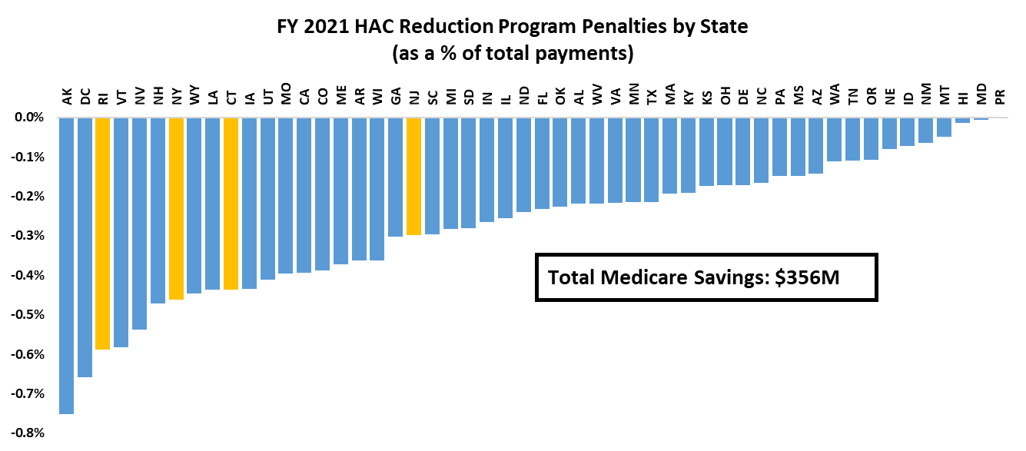
HAC Financial Impacts (based on FY 2021 payments & HAC penalty scores)
1% penalty on total IPPS payments for hospitals performing in the bottom quartile nationwide
$ | NY | NJ | CT | RI
Penalty | 44.5m | 12.5m | 7.4m | 2.2m
Estimates are based on FY 2021 Medicare FFS payment rates, case counts and case-mix indices.
Notes:
Check for Updates

Slide 25
FY 2021 VBP Program Scoring
CLABSI SIR
CAUTI SIR
SSI SIR
MRSA SIR
Safety
The domains are equally weighted. This accounts for different numbers of measures in different domains.
C.diff SIR
AMI Mortality
Measures are scored on achievement and improvement then added together to generate domain scores
HF Mortality
Clinical Outcomes
Pneumonia Mortality
The Total Performance Score is the weighted average of the domain scores
COPD Mortality
Total Performance Score
Total Hip/Knee Arthroplasty Complications
Efficiency
MSPB
Communication with Nurses
Communication with Doctors
Responsiveness of Hospital Staff
Patient Experience
Communication about Medicines
Cleanliness & Quietness
Discharge Information
Care Transition
Overall Hospital Rating

Slide 26
An example of VBP Achievement and Improvement Scoring: Central Line Associated Bloodstream Infection (CLABSI) Standardized Infection Ratio (SIR)
Achievement Points: 0 - 10 points
Improvement Points: 0 - 9 points
0
10th Percentile : 0
50th Percentile : 0.69
Achievement
Threshold
Benchmark
The measure score is the higher of these two scores.
0
10th Percentile : 0
Hospital Baseline SIR
Benchmark

Slide 27
FY 2021 VBP Program Scoring
CLABSI SIR
CAUTI SIR
The domains are equally weighted. This accounts for different numbers of measures in different domains.
SSI SIR
MRSA SIR
Safety
C.diff SIR
AMI Mortality
Measures are scored on achievement and improvement then added together to generate domain scores
HF Mortality
Total Performance Score
Clinical Outcomes
The Total Performance Score is the weighted average of the domain scores
Pneumonia Mortality
COPD Mortality
Total Hip/Knee Arthroplasty Complications
Efficiency
MSPB
Communication with Nurses
Communication with Doctors
Incentive pool funded by 2% withhold of base operating payments ($190 million)
Budget neutral within hospital industry, but redistributive
Responsiveness of Hospital Staff
Patient Experience
Communication about Medicines
Cleanliness & Quietness
Discharge Information
Care Transition
Overall Hospital Rating

Slide 28
VBP Exchange Function
Incentive pool funded by 2% withhold of base operating payments ($190 million)
Budget neutral within hospital industry, but redistributive

Slide 29
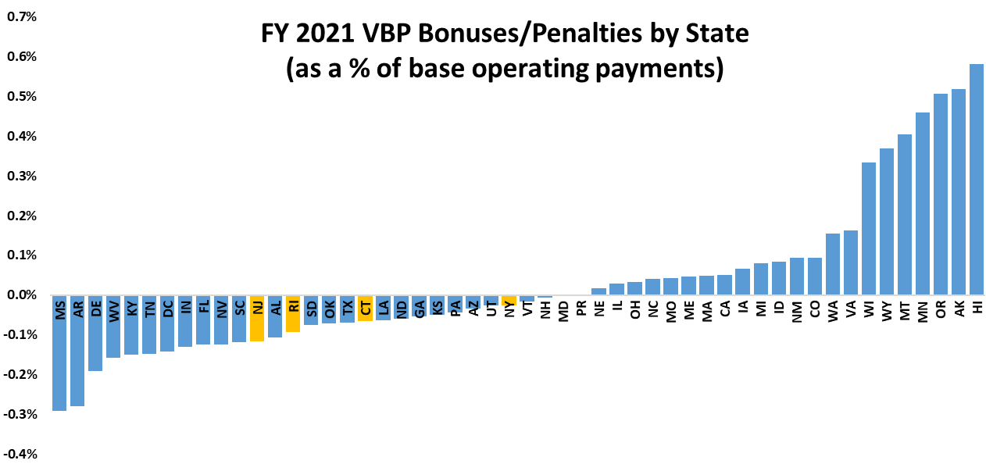
VBP Financial Impacts (based on FY 2021 estimated payments and adjustment factors)
Total Medicare Savings: $0
Redistribution: $190M
$ (+/-) | NY | NJ | CT | RI
Bonuses | 11.6m | 2.8m | 1.3m | 0.5m
Penalties | -14.0m | -7.4m | -2.3m | -0.8m
FY 2021 VBP bonuses/penalties are estimated using Medicare FFS payment rates, case counts and case-mix indices.
Notes:
Check for Updates

Slide 30
FY 2021 HRRP Scoring
The Readmissions Adjustment Factor is one minus the weighted average of ERRs minus a hospital’s peer group median ERR where the weights are the Base Operating DRG Payments as a proportion of total DRG payments for each condition
AMI Payments
X
AMI ERR –
Peer Group Median*
Heart Failure Payments
X
Heart Failure ERR –
Peer Group Median*
Pneumonia Payments
X
Pneumonia ERR –
Peer Group Median*
1 -
Total Hip/Total Knee Arthroplasty Payments
X
Total Hip/Total Knee Arthroplasty ERR – Peer Group Median*
COPD Payments
COPD ERR –
Peer Group Median*
Readmissions Adjustment Factor
X
CABG Payments
X
CABG ERR –
Peer Group Median*
Payments as a proportion of total payments
ERR Excess Readmission Ratio
* if this number is less than 0, it is set to 0

Slide 31
FY 2021 HRRP Scoring
The influence of a measure is based on its weight
AMI Payments
X
AMI ERR –
Peer Group Median*
Heart Failure Payments
X
Heart Failure ERR –
Peer Group Median*
Pneumonia Payments
X
Pneumonia ERR –
Peer Group Median*
1 -
Total Hip/Total Knee Arthroplasty Payments
X
Total Hip/Total Knee Arthroplasty ERR – Peer Group Median*
COPD Payments
COPD ERR –
Peer Group Median*
Readmissions Adjustment Factor
X
CABG Payments
X
CABG ERR –
Peer Group Median*
Payments as a proportion of total payments
ERR Excess Readmission Ratio
* if this number is less than 0, it is set to 0

Slide 32
FY 2021 HRRP Scoring
ERR = Predicted
Expected
A hospital’s peer group is defined by its
% of dual eligible patients
AMI Payments
X
AMI ERR –
Peer Group Median*
Heart Failure Payments
X
Heart Failure ERR –
Peer Group Median*
Pneumonia Payments
X
Pneumonia ERR –
Peer Group Median*
1 -
Total Hip/Total Knee Arthroplasty Payments
X
Total Hip/Total Knee Arthroplasty ERR – Peer Group Median*
COPD Payments
COPD ERR –
Peer Group Median*
Readmissions Adjustment Factor
X
CABG Payments
X
CABG ERR –
Peer Group Median*
Payments as a proportion of total payments
ERR Excess Readmission Ratio
* if this number is less than 0, it is set to 0

Slide 33
Implications of the HRRP Scoring Algorithm
ERR = Predicted
Expected
ERR < 1: Predicted is less than expected
ERR = 1: Predicted = Expected
ERR > 1: Predicted is higher than expected
Hospital performs better than expected
Hospital performs worse than expected
Hospital performs as expected
Peer Group Median
ERR = 1

Slide 34
Implications of the HRRP Scoring Algorithm
ERR = Predicted
Expected
ERR < 1: Predicted is less than expected
ERR = 1: Predicted = Expected
ERR > 1: Predicted is higher than expected
Hospital performs worse than expected
If a hospital’s peer group median changes, this can affect its penalty
Peer Group Median ERR > 1
Peer Group Median
ERR = 1
A hospital’s penalty is based on the distance between the hospital ERR and its peer group median
Hospital ERR – Peer Group Median
Hospital ERR – Peer Group Median

Slide 35
Implications of the HRRP Scoring Algorithm
ERR = Predicted
Expected
ERR < 1: Predicted is less than expected
ERR = 1: Predicted = Expected
ERR > 1: Predicted is higher than expected
If a hospital is performing better than the peer group median, the distance between the hospital ERR and peer group median is capped at 0
Hospital Performance
Hospital Performance
Peer Group Median ERR = 1
Hospital ERR – Peer Group Median

Slide 36
Implications of the HRRP Scoring Algorithm
ERR = Predicted
Expected
ERR < 1: Predicted is less than expected
ERR = 1: Predicted = Expected
ERR > 1: Predicted is higher than expected
Hospital Performance
A hospital can be performing better than expected and still receive a penalty based on its peer group median
Peer Group Median ERR < 1
Peer Group Median ERR = 1
Hospital ERR – Peer Group Median
Hospital ERR – Peer Group Median

Slide 37
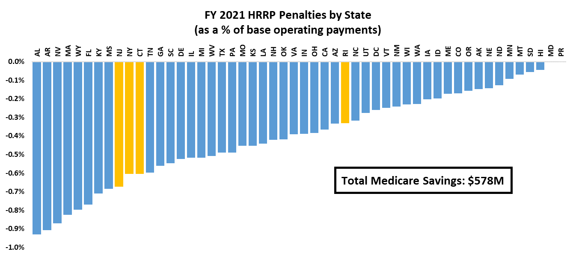
HRRP Financial Impacts (based on FY 2021 estimated payments & adjustment factors)
Reduces payments to hospitals by up to 3% of base operating payments
$ (-) | NY | NJ | CT | RI
Penalty | 54.1m | 26.2m | 9.6m | 1.2m
FY 2021 HRRP penalties are estimated using Medicare FFS payment rates, case counts and case-mix indices.

Slide 38
Considerations in Tackling Medicare Quality-based Payment Programs
Clinical care occurs
Measurement
Scoring Algorithm
Payment Adjustment

Slide 39
Common Barriers to Improvement in Medicare Quality-based Payment Programs
Moving target
Measures are updated by measure stewards
Policy is updated on an annual basis
Other hospitals in the programs are working on the same program

Slide 40
Common Barriers to Improvement in Medicare Quality-based Payment Programs
Data period
Data is at least 2 years old
Some data spans multiple years
GNYHA Measures and Performance Periods: https://www.gnyha.org/data/measures-and-performance-periods-for-the-fy-2022-ipps-final-rule/

Slide 41
Common Barriers to Improvement in Medicare Quality-based Payment Programs
Complex measures
Measures based on algorithms that cannot be replicated
May use data hospitals do not have access to
Disconnect from hospital QI

Slide 42
Common Barriers to Improvement in Medicare Quality-based Payment Programs
Complex scoring algorithms
Scores based on algorithms that cannot be replicated
May use data hospitals do not have access to

Slide 43
Common Barriers to Improvement in Medicare Quality-based Payment Programs
Dealing with multiple programs
Hospitals are subject to multiple programs in and out of Medicare with different measures and methods
There may be measures common across programs but have different impacts
GNYHA Quality Measures by Program: https://www.gnyha.org/data/fy-2022-ipps-final-rule-quality-measures-by-program/

Slide 44
Common Barriers to Improvement in Medicare Quality-based Payment Programs
Hospital’s ability to impact
Some measures are influenced by factors outside a hospital’s control

Slide 45
Concerns about Medicare P4P Programs
Potential for systematic risk
Opportunity for policymakers to redesign programs to improve equity, reduce systematic risk
*Impact on Medicare IPPS fee-for-service payments only; also affects Medicare Advantage payments.

Slide 46
Link: https://www.gnyha.org/tool/health-care-terms-2022/

Slide 47
Questions?
Contact:
John Gravina (jgravina@gnyha.org)

