Slide 1
On-site Fitness Facilities
Paulette Giambalvo, MPH, CHES
Director
Montefiore To your Health! Associate Wellness
Shirley Symister
Project Manager
Montefiore To Your Health! Associate Wellness

Slide 2
Meeting Physical Activity Guidelines
It is recommended Americans have 150 minutes of physical activity a week.
Research has found that access to on-site fitness facilities at work may make it easier for employees to integrate physical activity into their workdays.
A study that examined the association of worksite policies and environments with physical activity found employees with access to fitness facilities at work were:
40% more likely to meet physical activity recommendations overall
70% more likely to meet physical activity recommendations through walking
Das BM, Mailey E, Murray K, et al. From sedentary to active: Shifting the movement paradigm in workplaces. Work. 2016;54(2):481-7.
Dodson EA, Lovegreen SL, Elliott MB et al. Worksite Policies and Environments Supporting Physical
Activity in Midwestern Communities. Am J Health Promot. 2008; 23(1):51–55.

Slide 3
On-site Fitness Facilities and Health
In addition to meeting the physical activity guidelines, having an on-site fitness facility at work may have the potential to effectively improve employees’ health and substantially reduce health care costs.
For institutions that have fitness facilities, such as the Mayo Clinic, an evaluation found that members had a greater prevalence of regular exercise than nonmembers:
Over 2/3 of members and over 1/2 of nonmembers participating in regular exercise
The prevalence of cardiovascular exercise was greater in members than nonmembers at all points in time, with no significant changes over time in either group.
While members were more active and healthier than non-members, these data also suggest that members were systematically healthier than non-members.
It is unclear if the presence of an on-site fitness facility caused people to be more active or if the facility was simply used by people who were more active.
Abu Dabrh AM, Gorty A, Jenkins SM, et al. Health Habits of Employees in a Large Medical Center: Time Trends and Impact of a Worksite Wellness Facility. Sci Rep. 2016;6:20804.

Slide 4
On-site Fitness Facilities and Health Cont. Mayo Clinic Study Findings

Slide 5
On-site Fitness Facilities and Health
A study of 1151 members at an academic medical center’s worksite wellness facility found that wellness facility use during a 12-month period was significantly associated with improvements in physical quality of life and body mass index (BMI).
Of note, no comparison group was included in the study.
In a retrospective analysis of the impact of wellness center attendance on weight loss and costs at the Mayo Clinic, the results indicate that compared with the visit category of 0 to 60 visits, the visit category of 181 to 360 visits was associated with 63% higher likelihood of losing 10% or more weight.
The analysis also found that the visit category of more than 360 visits was associated with 2.8 times higher likelihood of dropping weight by 10% or more.
Clark MM, Jenkins SM, Limoges KA, et al. Is usage of a wellness center associated with improved quality of life? Am J Health Promot. 2013;27(5):316-22.
Borah BJ, Egginton JS, Shah ND, et al. Association of worksite wellness center attendance with weight loss and health care cost savings: Mayo Clinic's experience. J Occup Environ Med. 2015;57(3):229-34

Slide 6
Fitness Facility Utilization
Tabak, et. al. found that supervisors were more likely to report using flextime for physical activity.
The facilities were more heavily utilized by those with a commute time of 15 minutes to 29 minutes, compared to those with longer or shorter commute times.
This study also found that indoor exercise facilities were utilized the most by those working rotating/other shift schedules, followed by those working regular day shifts, with regular evening/night shifts reporting the lowest use.
In addition, policy and environmental supports of an active lifestyle were found to be most important at the fitness facilities with early morning and late evening hours (i.e., showers.)
Across available research, overall involvement in on-site fitness facilities ranges from 16-40% among the eligible employee populations.
Tabak RG, Hipp A, Marx CM, et al. Which worksite supports for healthy weight do employees use? Environ Behav. 2016; 48(1): 131–149.
Das BM, Mailey E, Murray K, et al. From sedentary to active: Shifting the movement paradigm in workplaces. Work. 2016;54(2):481-7.
Clark MM, Jenkins SM, Limoges KA, et al. Is usage of a wellness center associated with improved quality of life? Am J Health Promot. 2013;27(5):316-22.
Abu Dabrh AM, Gorty A, Jenkins SM, et al. Health Habits of Employees in a Large Medical Center: Time Trends and Impact of a Worksite Wellness Facility. Sci Rep. 2016;6:20804
Burton WN, McCalister KT, Chen CY, Edington DW. The association of health status, worksite fitness center participation, and two measures of productivity. J Occup Environ Med. 2005;47(4):343-51.

Slide 7
On-site Fitness Facilities Cost & Productivity Impact
A study that examined the associations between worker productivity and participation in a worksite fitness center found:
The differences in lost work wages caused by disability between fitness center participants and nonparticipants amount to a cost avoidance of $258 per employee.
Fitness center participants compared with nonparticipants experienced a lesser incidence of short term disability claims.
In addition, a study examining the relationship between physical activity and short-term health care costs among 23,490 employees found that sedentary employees had statistically higher medical costs than moderately and very active employees.
Active employees, who did regular physical activity even once or twice a week, were less likely to report chronic diseases than those totally sedentary employees. This suggests that physical activity may compensate, to some extent, for the adverse effects of excess body fat and avoid some of the health care costs associated with comorbidities.
Peer-reviewed research studies have found that on-site fitness facilities at work may make it easier for employees to become more active, reduce their weight, improve employees’ quality of life, and lower health care costs.
Burton WN, McCalister KT, Chen CY, Edington DW. The association of health status, worksite fitness center participation, and two measures of productivity. J Occup Environ Med. 2005;47(4):343-51.
Wang F, McDonald T, Champagne LJ, Edington DW. Relationship of body mass index and physical activity to health care costs among employees. J Occup Environ Med. 2004 May;46(5):428-36.

Slide 8
Recommended Features
Opening and maintaining a facility that is secure but accessible to the greatest number of employees.
Extended hours of operation (possibly a minimum of 12 hours a day) with early morning and late evening hours to accommodate different associate schedules.
Having a facility fully equipped with changing rooms, lockers, and showers along with accessible exercise equipment such as fit balls and hand weights to make it easier for employees to integrate physical activity into their workdays.
Having an attendant to:
Ensure the proper maintenance of the facility
Provide direction on how to use the available amenities, and
Provide fitness education and fitness classes.
Charging a modest cost to offset operational expenses, either competitive with or less than facilities in the area.

Slide 9
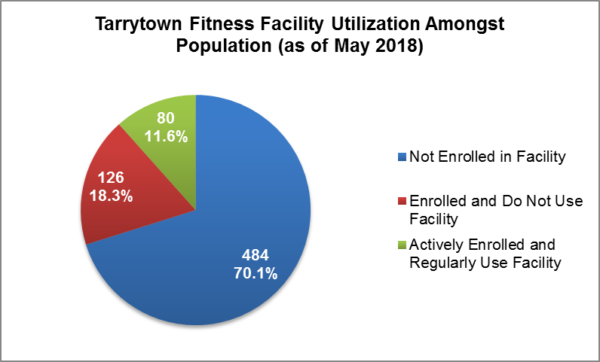
Montefiore On-site Facility: Tarrytown Location
Opened in October 2016, Montefiore associates at the Tarrytown campus have provided a test-case of the impact of this programming:
Of note: this facility has limited hours and is using equipment left behind by its prior occupant.
The average number of visits to the facility per active users of the facility was six visits within a month.
Across all days the facility is most utilized during weekdays, with Fridays being the least popular day of utilization.
The most active hours the facility is utilized are from 11:00am and 2:00pm.

Slide 10
“Biggest Winner” Weight Loss Challenge
In February of 2018 the Tarrytown facility launched “The Biggest Winner”, a 10-week team based weight loss challenge program. The program participants completed a pre- and post-program biometric assessment. The “Biggest Winner” program included a multi-pronged approach to produce substantial and sustainable change, including:
Four webinar videos that were distributed to promote participant mastery and independence in exercise
Weekly weigh-ins for accountability
Weekly emails and health fitness information and tips to keep teams focused
Team structure to harness social motivation, and
Mid-program and post-program recognition.
Outcomes: The “Biggest Winner” program garnered positive feedback, with:
18% of the membership population (40 associates) enrolled in the program.
75% (30 associates) of participants met all the program requirements including attending all 10 weekly weigh-ins, group training sessions or other forms of exercise and training, and viewing all four webinars.
36% decreased their weight by 9 lbs. or more and 27% decreased their waist measurement by 2-3 inches.
In addition to exceeding the goals set by the facility staff, 70% of participants increased strength and decreased body fat/weight/BMI, 60% felt healthier, happier and more positive, and 60% felt more productive at work. Following their participation in the program, 81% of participants rated the program as good to excellent, and 80% said they have confidence in their ability to continue managing their weight.
EXOS. Executive Summary – Montefiore Biggest Winner. 2018. Data on File.

Slide 11
Limitations
First, the available research tends to simply compare participants to non-participants, which means that any beneficial impact of on-site gym facilities may simply reflect differences in who participants vs. does not participate in such programming.
In addition, many of the studies combine an on-site gym with other incentives/interventions such as cash incentives, reduced health insurance premiums.
Other studies included information on facility utilization without providing detailed information on amenities and hours. Also other studies had fitness facility memberships available to other groups outside of current employees (i.e., spouses, retirees, volunteers).
In addition, using information from the Tarrytown experience to inform other potential experiences may be problematic given the limited hours and older equipment for the Tarrytown location. In addition, the staff at Tarrytown are administrative and not clinical.

